Slide 1


Employees:
Joseph Hong, Haresh Bhatia, and Keerat Sandhu

Slide 2
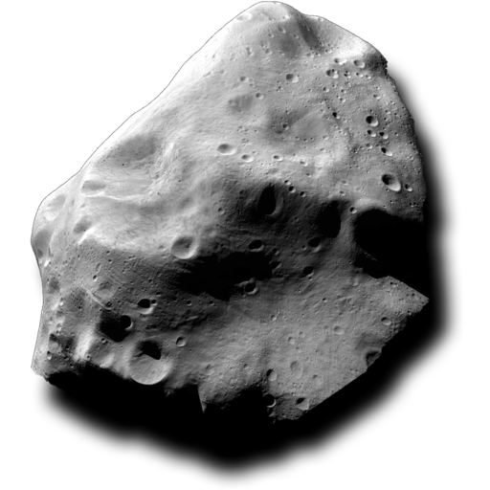


Slide 3



Slide 4

